Slide 1
Disclaimer
Certain information in this presentation may outline Broadcom's general product direction.
This presentation shall not serve to (i) affect the rights and/or obligations of Broadcom or its licensees under any existing or future license agreement or services agreement relating to any Broadcom software product; or (ii) amend any product documentation or specifications for any Broadcom software product.
This presentation is based on current information and resource allocations and is subject to change or withdrawal by Broadcom at any time without notice.
The development, release and timing of any features or functionality described in this presentation remain at Broadcom's sole discretion.
Notwithstanding anything in this presentation to the contrary, upon the general availability of any future Broadcom product release referenced in this presentation, Broadcom may make such release available to new licensees in the form of a regularly scheduled major product release.
Such release may be made available to licensees of the product who are active subscribers to Broadcom maintenance and support, on a when and if-available basis.
The information in this presentation is not deemed to be incorporated into any contract.
Notes:
The information that we are about to share provides information about our product direction that is currently in planning, but has not yet been committed.
This is for informational purposes only and should not be incorporated into any contract.

Slide 2

VMware Cloud Foundation 9
Revision Date: September 13th, 2024
This deck is meant for General Informational Usage.
Use accordingly and note that references are called out, together with correct RevRec and Legal slide language.
The information in this presentation is for informational purposes only and may not be incorporated
into any contract. There is no commitment or obligation to deliver any items presented herein
Notes:
This presentation provides an overview of the planned positioning, features and messaging for VMware Cloud Foundation 9 that will be announced at VMware Explore 2024 Las Vegas.
Note that this content is being provided for informational purposes only and this content shall NOT BE INCLUDED INTO ANY CONTRACTUAL TERMS.
IMPORTANT NOTE FOR INTERNAL AUDIENCES: VCF 9 IS “IN PLANNING” AND THUS NO DATES OR TIMELINES ARE TO BE SHARED INTERNALLY OR EXTERNALLY.
DO NOT REFERENCE “NEXT RELEASE” OR “VCF 9.0”

Slide 3





Your Current Cloud Strategy is Not Working
ON-PREM INFRASTRUCTURE
PUBLIC CLOUD
TRADITIONAL, SILOED 3-TIER
IaaS CONSUMPTION
ORCHESTRATION
STORAGE
INFRASTRUCTURE
COMPUTE
SECURITY
NETWORKING
High Cost. Low Agility
High Cost. Limited Privacy
34% higher overall infrastructure cost¹
51% customers concerned with privacy ²
50% lower team efficiency¹
39% customers consider cloud migration expensive and complex to manage³
¹IDC White Paper, sponsored by VMware by Broadcom, The Business Value of VMware Cloud Foundation, doc #US52312224, August 2024
2 IDC FutureScape. "The Infrastructure and Cloud Impact - 2024 Predictions." (Data Source: IDC Worldwide Generative AI Study, August 2023. WW N=1363.)
³Forrester Research.- Cloud Security — Reality Strikes After Migration
3
Notes:
Talk Track
When organizations are looking to modernize infrastructure, they are often faced with multiple options and find that each option has significant trade-offs.
Traditional 3-Tier Architectures
Organizations view upgrades to their existing legacy 3-tier infrastructure technology stacks as a shortcut to get to the desired outcomes, but this approach tend to be challenged because it carries a lot of technical debt and maintains the siloed approach to deploying infrastructure which is not suited for their modernization strategy. IDC Data shows that legacy infrastructure can result in 34% more infra costs and 50% lower team efficiency as compared to a modern private cloud.
Native Public Cloud
To overcome these limitations, many have gone all in on Native Public Cloud that delivers agility, scalability, IaaS consumption etc., but it comes with its own challenges such as cloud migration costs, hidden service fees, egress and data transfer costs and security and compliance related vulnerabilities. 51% of customers surveyed by Forrester had significant concerns about privacy and 39% found that cloud migrations were complex and and expensive.

Slide 4




Agile
Self-Service
Developer
Ready
Secure and Resilient
Cost Efficient
Compliant
The Private Cloud Journey
What You Truly Need is
The Best of Both Worlds
Broadcom Proprietary and Confidential. Copyright © 2024 Broadcom.
All Rights Reserved. The term “Broadcom” refers to Broadcom Inc. and/or its subsidiaries.
Notes:
And that’s where Private Cloud comes into picture.
A modern private cloud platform offers the best of both worlds - delivering the scale, flexibility and agility of cloud computing - with enhanced security, control, and governance customized to meet needs of each organization.
Many organizations have different strategic initiatives and are at different stages of their cloud journeys.
What is common is that most organizations need a self-service, infrastructure platform so that their devops, platform and data science teams can bring innovation to the market faster with cost efficiencies that lower total cost of ownership (TCO)..

Slide 5
Take the first step with
4
Deliver the Journey
Deliver a prescriptive deployment that achieves the business outcomes
3
The Cloud Maturity Model
Map Business Outcomes
Leverage our existing methodology map business outcomes to specific use cases
2
Assess Your Needs
Helping you on the journey to reaching your goals
Assess and review technical requirements and business objectives
Meet You Where You Are
1
Start with the VMware software
that you have
Notes:
But the path to building a private cloud can be complex, with many steps and considerations along the way. Recognizing these challenges, Broadcom is making significant investments in a program designed to help customers navigate their private cloud transformation journey with VMware Cloud Foundation. By providing expert guidance, tailored training, and innovative resources, Broadcom ensures that businesses can confidently transition to a private cloud, regardless of where they are in their private cloud journey.
Customers can take advantage of the following elements of the program designed to help them advance along the stages of their organizational maturity and up-level the skills of their workforce:
Private Cloud Maturity Model
VCF Jumpstart Workshops
New VMware Cloud Foundation Certification
Free Digital Learning and Instructor-led Training

Slide 6

VMware Cloud Foundation – The Private Cloud Platform
What Customers Can Achieve Today
564% 3-Year ROI
with 10 Months Payback
AUTOMATION AND OPERATIONS
34% Lower
Infrastructure Costs
Compute
Storage
Networking
61% Faster
to Deploy new Workloads
66% Quicker
to Resolve Data Loss Incidents
Customer Managed On-Premises, Edge
Provider Managed Public or Partner Clouds
IDC White Paper, sponsored by VMware by Broadcom, The Business Value of VMware Cloud Foundation, doc #US52312224, August 2024
Notes:
VMware Cloud Foundation is the industry’s first private cloud platform to deliver public cloud scale and agility with private cloud security, resilience and performance, and low overall total cost of ownership. VCF supports customers’ digital innovation with faster infrastructure modernization, a unified cloud experience, and better cyber resiliency and platform security and low total cost of ownership.
In August 2024, IDC published a business value report to demonstrate financial benefit impact by interviewing 8 organizations using VCF to establish and run private and hybrid clouds and then built a detailed financial model.
When compared with legacy 3-tier infrastructure, the financial results are impressive:
564% 3-Year ROI with 10 Months Payback
34% Lower Infra costs
61% faster to deploy new workloads
66% quicker to resolve data loss incidents

Slide 7
VMware Cloud Foundation – The Private Cloud Platform
Overall
Cost
Reduction
40%
AUTOMATION AND OPERATIONS
Compute
Storage
Networking
When compared to public cloud savings*
Customer Managed On-Premises, Edge
*VMware Cloud Economics Team. Results based on actual customer environment analysis.
Notes:
This equates to measurable savings that many VCF customers are reporting after repatriating workloads from the public cloud.
According to recent customer environment analysis done by VMware Cloud Economics team, customers realized around 40% overall cost reduction when they moved to VCF from their public cloud environment.

Slide 8

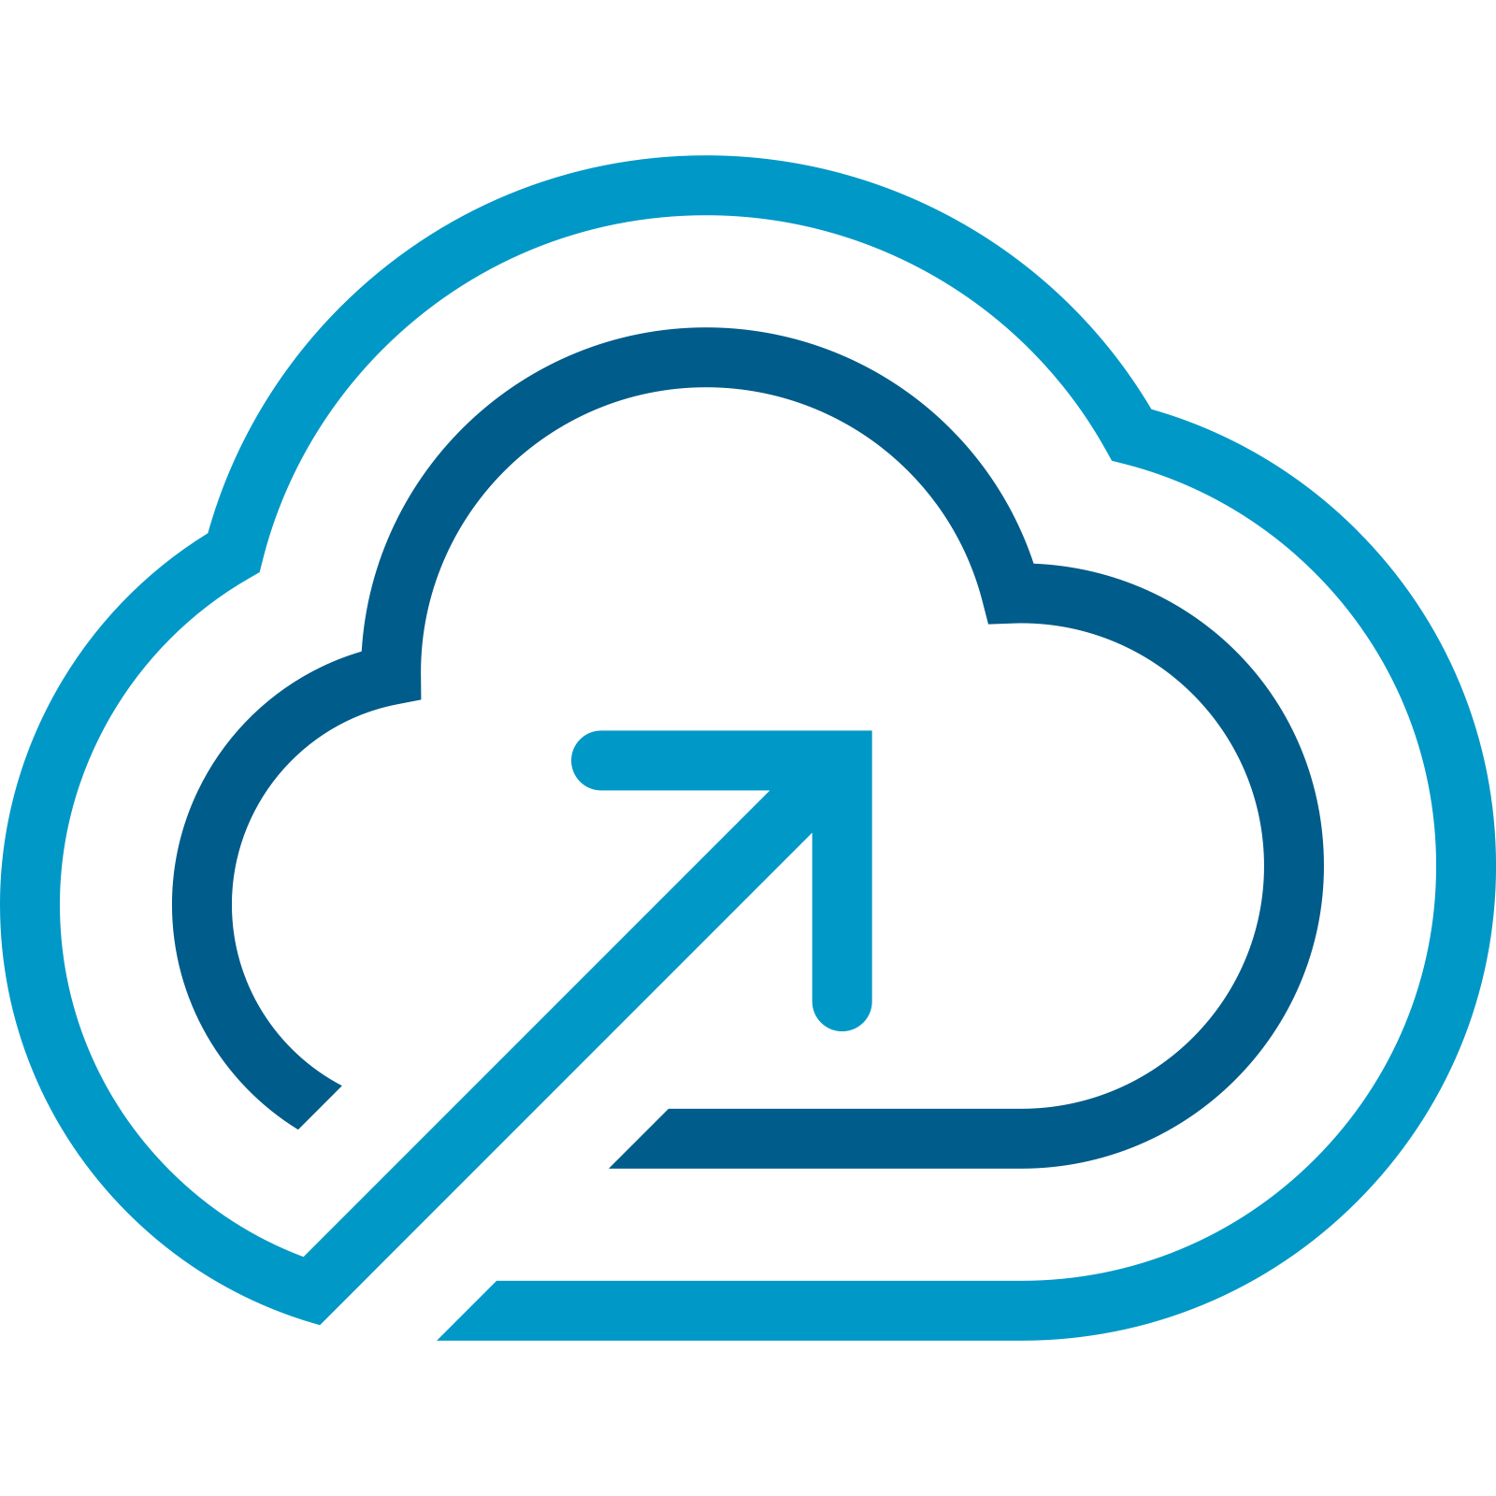
Unified Platform
Modern Infrastructure | Cloud Experience | Secure and Resilient
Introducing
VMware Cloud Foundation 9
Smarter Way to Cloud
The information in this presentation is for informational purposes only and may not be incorporated
into any contract. There is no commitment or obligation to deliver any items presented herein
Notes:
To help customers modernize their infrastructure, we are bringing an evolution in VMware Cloud Foundation with the launch of VMware Cloud Foundation 9. VCF 9 will deliver capabilities that enable their infrastructure to operate as a single unified and automated system, helping customers keep pace with modern app requirements, and bring the advanced VMware capabilities they already have from Broadcom into their private cloud platform.

Slide 9



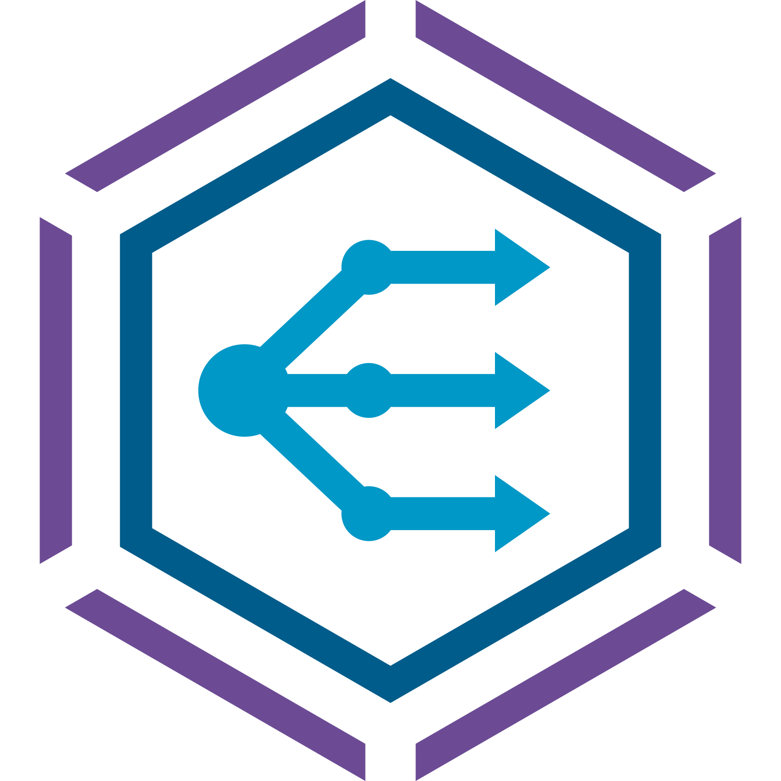




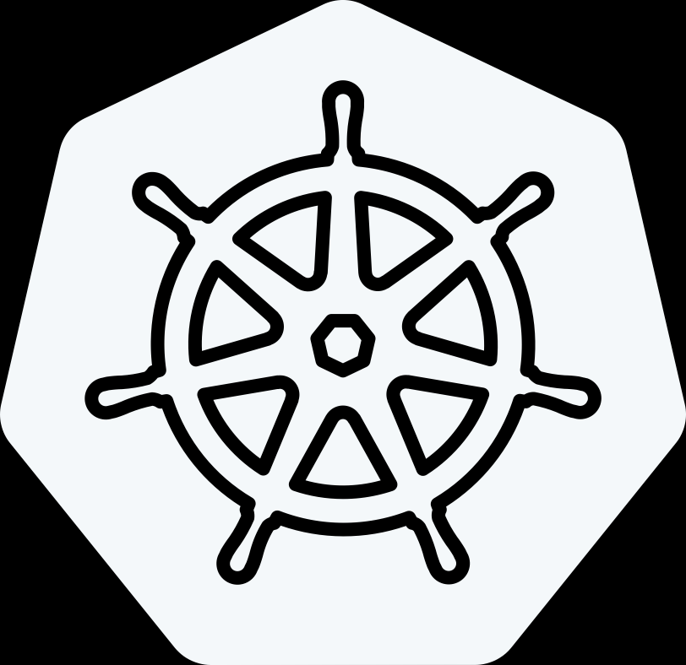

VMware Cloud Foundation 9 – The Unified Platform
Advanced Services
Private AI
Disaster
Recovery
Advanced
Security
Load Balancing
Container Operations
Data Services
Edge
Orchestration
Workload Automation
Modern Cloud Interface: AI/ML, K8s, Traditional VMs
MANAGE
OPERATE
CONSUME
Tenant Mgmt, Content
Service Catalog, Orchestration, Apps
AI / ML
K8s
Traditional VMs
DEVOPS
PLATFORM ENGINEER
BUILD
DEPLOY
OPERATE
MANAGE
Automation & Operations
OPERATE
Capacity, Tenancy, Configuration
SRE Ops, Fleet
and Security Mgmt
CLOUD ADMIN
Compute (vSphere)
Storage (vSAN)
Networking (NSX)
The information in this presentation is for informational purposes only and may not be incorporated
into any contract. There is no commitment or obligation to deliver any items presented herein
Notes:
With VMware Cloud Foundation 9, we are evolving VCF to address the challenges of 2 key personas-
Infrastructure teams- Cloud administrators and operators who build, deploy and operate an infrastructure
Infrastructure consumers- Platform engineers and DevOps teams who want to consume this infrastructure to deliver applications.
For Infrastructure Teams: VCF 9 will provide a single unified platform for automation and operations that provides an integrated experience to infrastructure teams to help them build, deploy and operate a private cloud infrastructure in a simple and efficient manner.
With fully integrated compute, storage, and networking capabilities and a VCF Installer for faster deployment, IT teams will be able to seamlessly build and deploy their private cloud on Day 0.
A unified VCF Operations console provides capacity management, tenant management, configuration of governance policies, and a consolidated VCF security dashboard, offering a unified management experience for performing Day 1 operations
To enhance overall resource optimization, VCF Operations provides important metrics for cost efficiency, governance, and control. With features like VCF Diagnostics, Performance Optimization, and Application Topology and Network Analysis, all backed by full automation capabilities, VCF Operations will simplify SRE and security operations, enable faster troubleshooting and improve the overall reliability of IT infrastructure.
With features such as global fleet level lifecycle management, One Identity and SSO Configuration, Single Subscription and Support Experience, it will streamline the Day 2 operations and minimize operational overhead of IT infrastructure teams.
For Infrastructure Consumers: VCF 9 will deliver a infrastructure platform with a modern cloud interface to run traditional VMs as well as Kubernetes, containers and AI/ML workloads.
With multi-tenancy and identity management capabilities, it will empower developers with self-service infrastructure provisioning to quickly and efficiently deploy resources tailored to their specific needs while maintaining isolation, security, and effective resource management across different projects or teams.
With governance policies, application blueprints and workflow orchestration, developers will be able to standardize the application deployment process, minimize errors, and accelerate the time-to-market for applications.
With an out-of-the-box IaaS consumption surface that includes an integrated Kubernetes runtime, an application catalog, APIs, CLIs, and a suite of services from ecosystem partners, VCF 9 will enhance the developer experience and will improve developer efficiency and productivity.
Additionally, you can extend the value of core VCF Platform with advanced services such as Private AI, Edge Orchestration, Data Services, Advanced Security services, Disaster Recovery, Load Balancing, Workload Automation and Container Operations. These advanced services help expand the use cases, bolster security and provide a comprehensive app development ecosystem.

Slide 10

VMware Cloud Foundation 9 – Business Outcomes
Streamlined Operational Efficiency
Accelerated Innovation for All Apps
Continuous Platform Resilience and Compliance
Rapid ROI and Time to Value
The information in this presentation is for informational purposes only and may not be incorporated
into any contract. There is no commitment or obligation to deliver any items presented herein
Notes:
VCF 9 Business Outcomes
Streamlined Operational Efficiency: With a unified, integrated platform, VCF 9 will enhance admin productivity, reduce operational overhead and costs, optimize resource management and streamline processes through advanced automation.
Accelerated Innovation for All Apps: VCF 9 will simplify and speed up infrastructure consumption for developers, enabling rapid infrastructure provisioning and deployment with unified governance and control, allowing developers to quickly bring any application—whether VMs, containers, Kubernetes, or AI/ML apps—to market with faster development cycles.
Continuous Platform Resilience and Compliance: With a comprehensive set of resiliency features and proactive compliance measures, VCF 9 will deliver a more reliable platform and will ensure operational stability, uninterrupted business operations and adherence to regulatory standards.
Rapid ROI and Time to Value: ​​With lower infrastructure costs, improved IT team efficiencies and development productivity gains, with VCF 9, customers will quickly realize significant returns on investment and accelerated time to value.

Slide 11
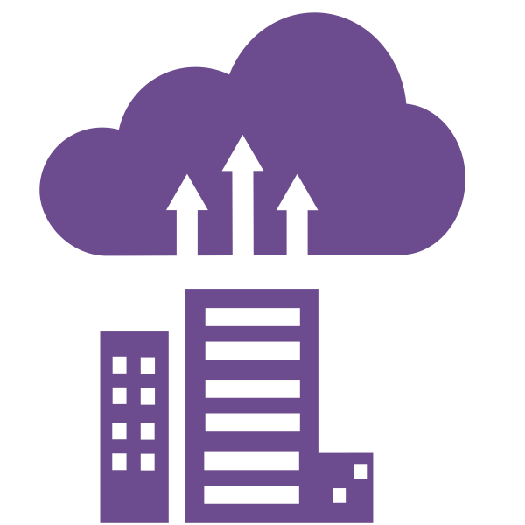


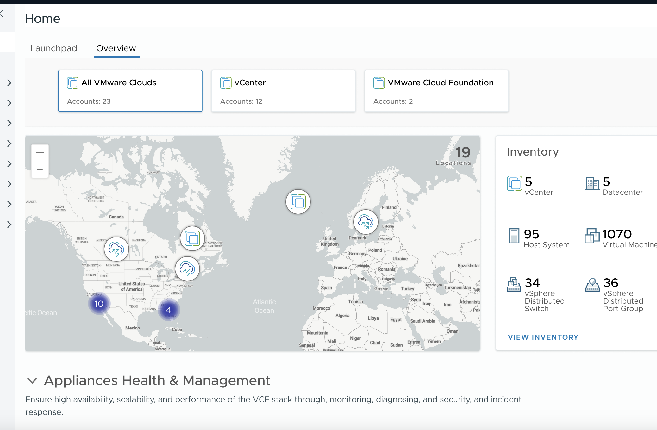

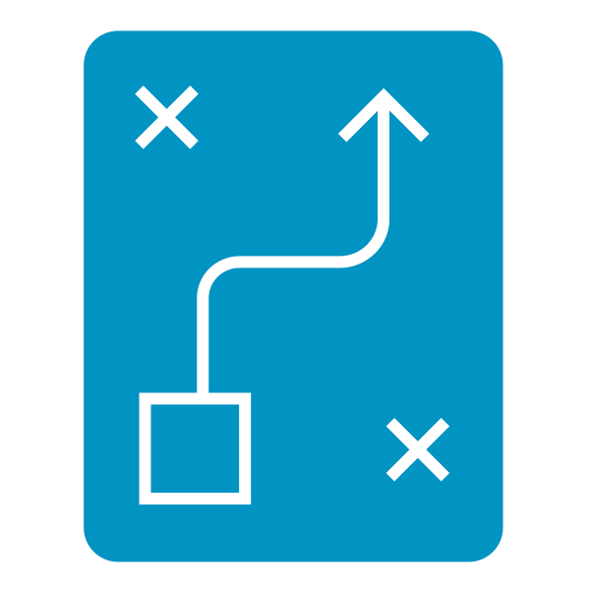

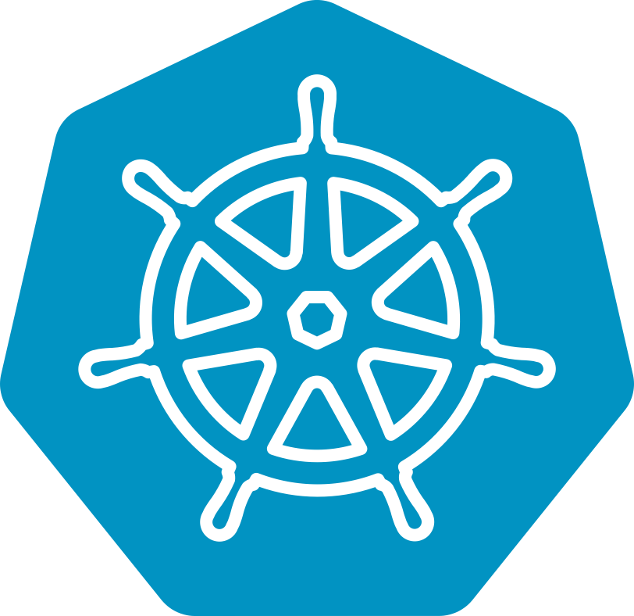
A Unified Platform for Operations and Automation
Private Cloud
Deployment
Tenant Management and Governance
BUILD
DEPLOY
OPERATE
CONSUME
Resource Management,
Governance, Security
Application
and Workflow Orchestration
CLOUD ADMIN
PLATFORM ENGINEER
DEVOPS
The image is for illustration only
Optimized Fleet
Management
Unified Cloud Experience
The information in this presentation is for informational purposes only and may not be incorporated
into any contract. There is no commitment or obligation to deliver any items presented herein
Notes:
For Infrastructure Teams: VCF 9 will provide a single unified platform for automation and operations that provides an integrated experience to infrastructure teams to help them build, deploy and operate a private cloud infrastructure in a simple and efficient manner.
Private Cloud Deployment: IT teams can deploy their private cloud on Day 0 with fully integrated compute, storage, and networking capabilities and a Quickstart App
Resource Management, Governance and Security: With a single unified console for capacity management, tenant management, configuration of governance policies, and a single VCF security dashboard, it will offer a unified management experience for performing Day 1 operations
Optimized Fleet Management: With global fleet level lifecycle management, One Identity and SSO Configuration, and Single Subscription and Support Experience, it will streamline the Day 2 operations.
For Infrastructure Consumers: VCF 9 will deliver a developer-ready infrastructure platform with a modern cloud interface to run traditional VMs as well as Kubernetes, containers and AI/ML workloads.
Tenant Management and Governance: With multi-tenancy and identity management, it will provide isolated, secure yet self-serve infrastructure to developers so that they do not have to rely on IT team for infrastructure resources.
Application and Workflow Orchestration: With application blueprints and workflow orchestration, developers will be able to standardize the application deployment process, minimize errors, and accelerate the time-to-market for applications.
Modern Developer Experience: With an out-of-the-box IaaS consumption surface with an integrated Kubernetes runtime, an application catalog, APIs, CLIs, and a suite of services from ecosystem partners, VCF 9 will enhance the developer experience and improve developer efficiency and productivity.

Slide 12
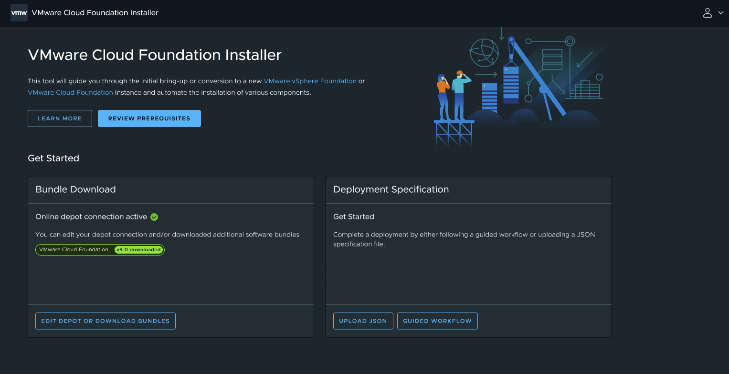
Build, Deploy and Operate the Private Cloud With Ease
Broadcom Proprietary and Confidential. Copyright © 2024 Broadcom.
12
Unified Cloud Admin Experience with the VCF Operations Console
VCF Build Experience
Quick Start App for VCF Deployment
Resource allocation with role-based access
Governance, cost management, and visibility
VCF SRE, Security, and Deploy Ops
VCF Diagnostics, Performance Optimization
Application Topology and Network Analysis
VCF Security Dashboard
VCF Management
Fleet Lifecycle: Plan, Schedule and Upgrade
One Place for Identity and SSO Configuration
Single Subscription and Support Experience
The image is for illustration only
VCF Operations Console
The information in this presentation is for informational purposes only and may not be incorporated
into any contract. There is no commitment or obligation to deliver any items presented herein
Notes:
Enhancements to the new VCF Operations Console:
VCF Build Experience: VCF 9 will simplify private cloud deployment with Quickstart App and a single console for streamlined resource management, role-based access, governance, cost management and end to end visibility
VCF SRE, Security and Deploy Ops: A unified console with VCF Diagnostics, Performance Optimization, Application Topology, Network Analysis and VCF Security Dashboard will enable seamless private cloud deployment and operations for SRE, Security and Operations teams.
VCF Management: : With global fleet level lifecycle management, One Identity and SSO Configuration, and Single Subscription and Support Experience, it will help streamline the Day 2 operations.

Slide 13
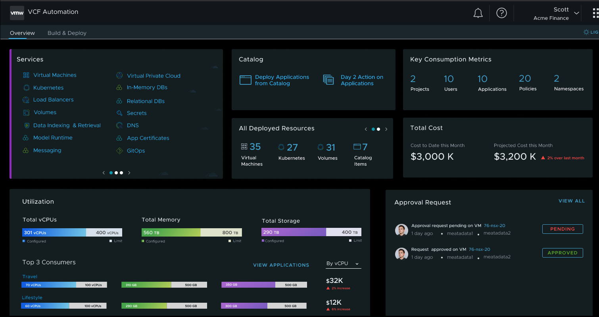
Drive A Modern Developer Experience and Consumption Model
13
Unified Consumption Experience with VCF Automation Console
Tenant Management
Organize and Allocate Tenant Resources
Tenant/LOB Admin Identity Management
Tenant Operations
Cloud Governance
Governance Policies
Application Blueprints
Workflow Orchestration
Developer Experience
Out-of-the-Box IaaS Surface for VCF
Application Catalog
Integrated Kubernetes
Ecosystem Services
The image is for illustration only
VCF Automation Console
The information in this presentation is for informational purposes only and may not be incorporated
into any contract. There is no commitment or obligation to deliver any items presented herein
Notes:
Enhancements in new VCF Automation Console:
Tenant management: With multi-tenancy, identity management and tenant specific operations, developers will be able to perform self-service infrastructure provisioning while maintaining isolation, security, and effective resource management across different teams.
Cloud Governance: With governance policies, application blueprints and workflow orchestration, developers will be able to standardize the application deployment process
Developer Experience: With an out-of-the-box IaaS consumption surface and integrated Kubernetes runtime, an application catalog, APIs, CLIs, and a suite of ecosystem services, VCF 9 will improve developer efficiency and productivity.

Slide 14
VMware Cloud Foundation 9 – Planned Key Features
Modern Infrastructure
Unified Cloud Experience
Secure and Resilient Platform
Unified Platform for Operations and Automation
Enhanced VCF Import – NSX, Multiple Topologies
Integrated
VCF Multi-Tenancy
Unified VCF Security Management
Advanced Memory Tiering with NVMe
Native VPCs in vCenter
and VCF Automation
Native vSAN-to-vSAN Data Protection with Deep Snapshots
The information in this presentation is for informational purposes only and may not be incorporated
into any contract. There is no commitment or obligation to deliver any items presented herein
Notes:
VMware Cloud Foundation 9 - Planned Key Features
Modernize Infrastructure:
Enhanced VCF Import: With VMware Cloud Foundation 9, there will be further enhancements to VCF Import capability released in 5.2. With these enhancements, customers will be able to import VMware NSX, VMware Avi Load Balancer and more complex storage topologies into existing VCF environments, and seamlessly integrate their older versions of existing infrastructure with minimal risks and complexities. Also, there will be a new intuitive UI. Benefits: Easy to integrate older versions of infrastructure, Simplified management and deployment of workloads with new UI.
Advanced Memory Tiering with NVMe: This feature is useful particularly for data intensive workloads such as AI/ML workloads, Big Data Analytics, e-commerce platforms and video streaming platforms. It will allow users to add memory capacity to a host by using an NVMe device as a secondary memory tier that is installed locally in the host, thus resulting in an increase of available memory within the ESXi host. It will utilize the NVMe devices as tiered memory and reduce the impact to performance by intelligently choosing which VM memory locations should be stored in the slower NVMe device vs faster dynamic random-access memory (DRAM) in the host. Benefits: improved overall CPU utilization, lowered TCO. Additionally, reduced latency and accelerated data throughput.
Unified Cloud Experience:
Integrated VCF Multi-Tenancy: With integrated VCF multi-tenancy capability, enterprise IT teams will be able to support different organizations, business groups or development teams on the same shared infrastructure, while allowing application owners and development teams to segment their infrastructure based on their own specific sovereign requirements for access, workload management, security and privacy.
Benefits: better resource utilization, improved infrastructure cost efficiency, enhanced security and privacy for tenants, improved agility, flexibility and infrastructure scalability.
Native Virtual Private Clouds (VPC) in vCenter and VCF Automation: VMware Cloud Foundation 9 will integrate native VPCs into vCenter and VCF Automation. With this capability, VI Admins will be able to create, consume and manage VPCs using either vCenter UI or they can even automate the deployment of VPCs with VCF Automation.
Benefits: a native networking experience with a single UI, A single management pane to discover NSX Projects, VPCs, their networks and security groups, rapid infrastructure provisioning and workload deployment without going through the complex ticketing process, streamlined operations, enhanced developer productivity, and reduced the operational overhead for IT teams.
Security and Resilience:
Unified VCF Security Management: A centralized information hub will provide timely and accurate security data in one place and a new comprehensive security view will provide visibility into multiple facets of security to view, manage and configure SSO, certificates, identity, passwords, notifications, tags. Configuration drift detection will correlate and proactively notify IT of inconsistencies in system configurations across an entire VCF fleet.
Benefits: A single-pane-of-glass view with comprehensive visibility into all security components, elevated security posture with faster incident response, enhanced threat protection, and improved compliance through unified reporting, increased the operational efficiency of the Security Operations team.
Native vSAN-to-vSAN Data Protection with Deep Snapshots. VCF administrators will be able to easily create, revert, restore, and clone snapshots and quickly recover from operational failures and disasters.
Customers can also leverage the deep, immutable vSAN snapshots to recover from ransomware attacks with an on-premises Isolated Recovery Environment (IRE). This complements the existing cloud-based ransomware recovery offering to provide greater choice and flexibility to customers who want to preserve data sovereignty and unlock the value of the full VCF stack to protect workloads anywhere.
Benefits: : strengthened data resilience with a deep history of immutable snapshots, reduced downtime with enterprise-grade disaster recovery orchestration, and simplified management experience with a unified appliance, increased scalability and storage efficiency

Slide 15

34% Lower TCO vSAN ESA with Global Dedupe
$10m in savings over 3 years compared to VCF with traditional storage
40% More Server Consolidation Memory Tiering with NVMe
VCF 9 By the Numbers
Reduced memory and licensing spend with advanced memory optimization and management
3x Switching Performance NSX Enhanced Data Path
High-performance networking mode to fully utilize physical network bandwidth
*"Based on internal Broadcom estimates. Results will vary from customer to customer
*The information in this presentation is for informational purposes only and may not be incorporated
into any contract. There is no commitment or obligation to deliver any items presented herein
Notes:
In addition to the impressive performance, operations and scale enhancements, VCF 9 is predicted to provide the following business benefits to organizations:
34% Lower TCO utilizing the vSAN ESA Global Dedupe capabilities
40% more server consolidation using the NVMe memory tiering that reduces memory and licensing requirements through improved memory optimization and management.
Triple the switching performance through the NSX Enhanced data path to fully utilize the underlying network bandwidth.

Slide 16
Leverage an Integrated IaaS Platform with a Rich Set of Services
AVAILABLE OUT OF THE BOX
VM and K8s Service
Network and Storage Services
AI Workloads
Certificate
Manager
Database
Management
Secrets and
Identity Store
Volume Service
Virtual Private
Cloud (VPC)
ADVANCED SERVICES
Private AI
Disaster Recovery
Advanced Security
Load Balancing
Container Operations
Data Services
Edge Orchestration
Workload Automation
PARTNER SERVICES
Object Store
Other Partner Services
Notes:
VMware Cloud Platform- An integrated IaaS platform with rich set of services:
Services available out of the box: The are the services natively integrated into the platform. These services are: VM and Kubernetes Service, Network and Storage services, AI Workloads, Certificate Manager, Database management, Secrets and identity store, Volume service and VPCs
Advanced services: These are the Broadcom offered services that will enhance the capabilities of your private cloud infrastructure and seamlessly integrate with VCF. These need to be purchased separately as add-ons. The services are: Private AI, DR, Advanced Security, Load Balancing, Container Operations, Data Services, Edge Orchestration, Workload Automation
Partner Services: These are the services provided by ecosystem partners that need to be purchased from partners. the include object store and other partner services.

Slide 17
Deep Dive and Backup Slides

Slide 18

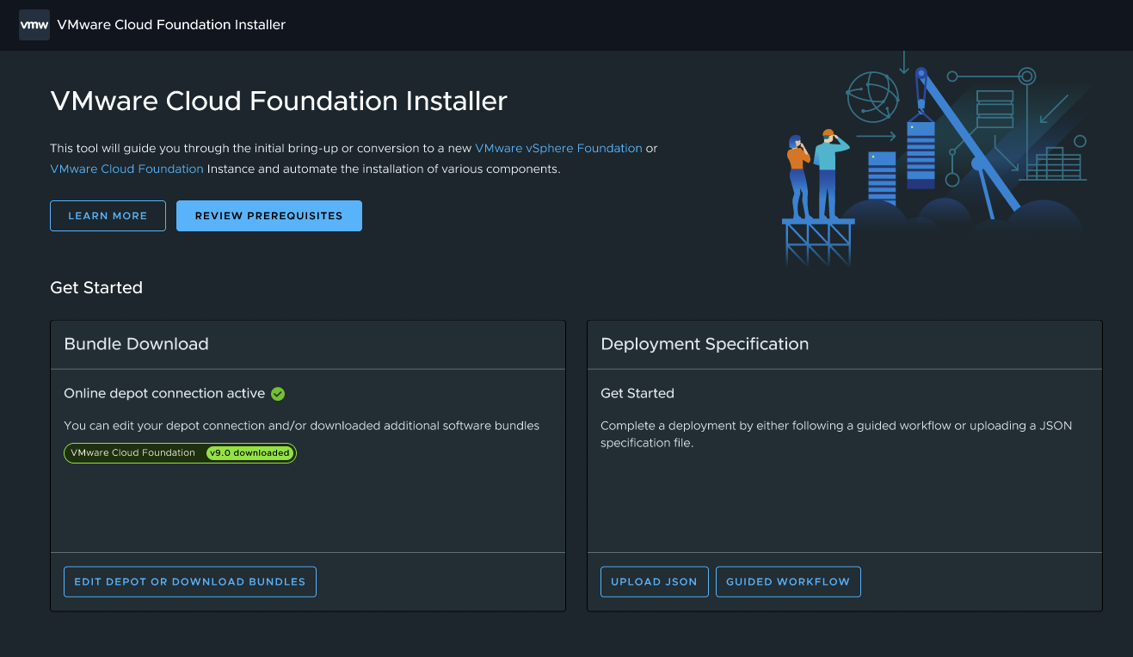

Enhanced VCF Import – Networking, Storage
Modernize Infrastructure
Extended Storage Support, UX/UI, Networking Integration
Enhanced VCF Import – NSX, Multiple Topologies
Customer Benefits
Smooth Integration: Effortlessly add NSX and complex storage topologies to existing environments.
Reliable Compatibility: Leverage and integrate older versions of existing infrastructure.
User-Friendly: Intuitive UI simplifies management and deployment.
Key Attributes
Default NSX Addition: NSX addition enabled by default during vSphere/vSAN environment import
Networking Options: Choice between 1 or 3 NSX Overlay nodes, with default on vmk0.
NSX Manager Deployment: NSX Managers deployed in the same cluster as the VC during import, ensuring colocation and compatibility.
Extensive Storage Topology Support: Support for various compute, logical, and edge topologies, excluding deprecated features and certain configurations.
The image is for illustration only
The information in this presentation is for informational purposes only and may not be incorporated
into any contract. There is no commitment or obligation to deliver any items presented herein
Notes:
Enhanced VCF Import:
The VCF Import capability released in VCF 5.2 helps customers convert and import existing vSphere, vSAN, VMFS-FC, and NFS environments into VMware Cloud Foundation instances so that organizations can transition quickly and easily to a more modern, reliable and integrated infrastructure with minimal downtime associated with manual migrations of existing environments into the VCF private cloud platform.
With VMware Cloud Foundation 9, there will be further enhancements to VCF Import capability that will help customers future-proof their existing infrastructure. With these enhancements, customers will be able to import VMware NSX, VMware Avi Load Balancer and more complex storage topologies into existing VCF environments, and seamlessly integrate their older versions of existing infrastructure with minimal risks and complexities. Also, the enhancements will include a new intuitive UI that will further simplify management and deployment of workloads.

Slide 19
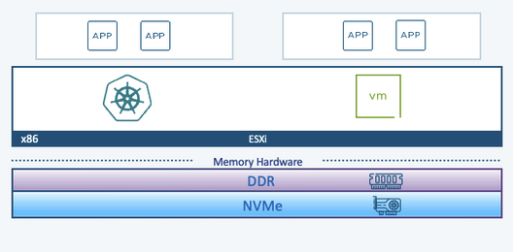
Advanced Memory Tiering with NVMe
Modernize Infrastructure
Cost-effective and efficient memory management for enhanced VM performance
NVMe Memory Tiering
Customer Benefits
Utilize NVMe as a second-tier memory to lower overall memory costs.
Leverage existing server slots for NVMe devices, maximizing hardware investment.
Enhance VM performance under memory pressure with advanced memory tiering algorithms.
Key Attributes
Cost Efficiency: NVMe tiering reduces DRAM costs by offloading 20-25% of memory accesses.
Advanced Tiering: Uses extensive hot/cold page analysis and LRU-like algorithms for optimal memory distribution.
Enhanced Visibility: Provides detailed DRAM and NVMe bandwidth stats for better VM management.
Avoids Ballooning Issues: Prevents guest OS slowdown and improves visibility into VM activity by avoiding ballooning.
The image is for illustration only
The information in this presentation is for informational purposes only and may not be incorporated
into any contract. There is no commitment or obligation to deliver any items presented herein
Notes:
Advanced Memory Tiering with NVMe: VMware Cloud Foundation 9 will introduce an exciting new feature - Advanced Memory Tiering with NVMe, especially for data intensive workloads such as AI/ML workloads, Big Data Analytics, e-commerce platforms and video streaming platforms that have large datasets and complex models and demand rapid data retrieval and processing.
This feature will allow users to add memory capacity to a host by using an NVMe device as a secondary memory tier that is installed locally in the host, thus resulting in an increase of available memory within the ESXi host. It will utilize the NVMe devices as tiered memory and reduce the impact to performance by intelligently choosing which VM memory locations should be stored in the slower NVMe device vs faster dynamic random-access memory (DRAM) in the host.
With increase in the memory footprint, NVMe tiering will also address core-to-memory imbalances and help in better workload and VM consolidation, thus improving overall CPU utilization while lowering the total cost of ownership. Additionally, NVMe Tiering will reduce latency and accelerate data throughput which is crucial for training and inference tasks in AI applications. It will also help scale the high storage demands without excessive increase in costs.

Slide 20
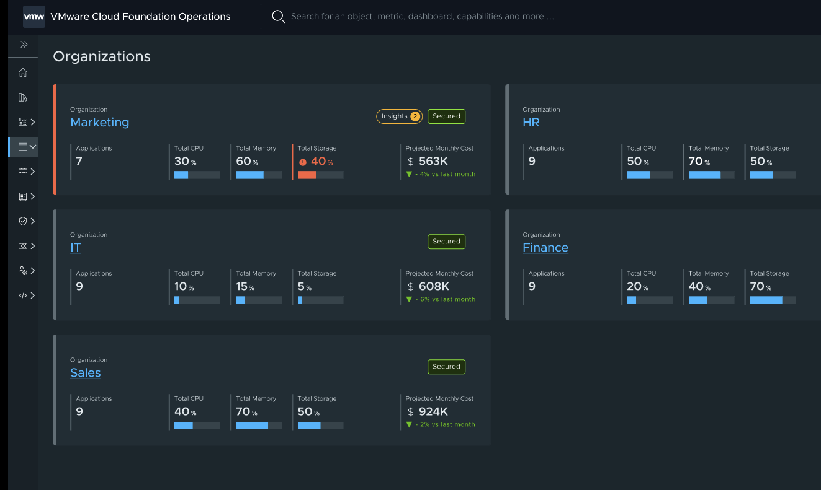
Native VCF Multi-Tenancy
Unified Cloud Experience
Streamlined, Secure and Scalable Cloud Management for Enterprises and Service Providers
Native VCF Multi-Tenancy
Customer Benefits
Increased Operational Efficiency and Reduced Overhead
Optimized Resource Allocations and Cost Savings
Easily Scale Tenants and Monitor Cost and Chargeback
Key Attributes
Seamless Integration: Tenant Manager is fully integrated into the VCF Console, providing a unified platform for managing both hard and soft tenancy models, ensuring ease of use and streamlined operations.
Advanced Resource Management: Utilizes sophisticated algorithms to allocate resources efficiently based on tenant needs and activity, ensuring optimal performance and cost-effectiveness.
Smooth Transition Paths: Offers non-disruptive upgrade paths for existing vSphere, vRA, and VCD customers, ensuring continuity and minimizing downtime during migration to the new system.
The image is for illustration only
The information in this presentation is for informational purposes only and may not be incorporated
into any contract. There is no commitment or obligation to deliver any items presented herein
Notes:
Integrated VCF Multi-Tenancy:
Today, customers need multi-tenancy in their private cloud environment so that multiple users or organizations (tenants) share the same underlying infrastructure and resources while maintaining data isolation and privacy. Now, with VMware Cloud Foundation 9, there will be multi-tenancy capabilities integrated out of the box into the VCF platform.
With integrated VCF multi-tenancy capability, enterprise IT teams will be able to support different organizations, business groups or development teams on the same shared infrastructure, while allowing application owners and development teams to segment their infrastructure based on their own specific sovereign requirements for access, workload management, security and privacy.
With multiple tenants sharing the same underlying infrastructure, this capability will provide better resource utilization and improved infrastructure cost efficiency. While at the same time, with data isolation and Role Based Access Control in place, it will provide tenants enhanced security and privacy. With rapid provisioning of new tenants and dynamic allocation of resources as per the demands of these tenants, it will help improve an organization's agility, flexibility and infrastructure scalability.

Slide 21
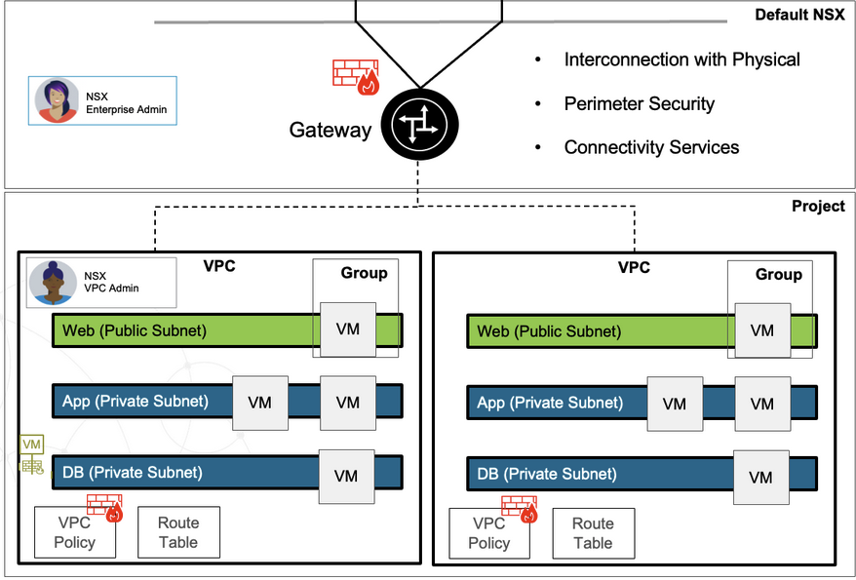
Native VPCs in vCenter and VCF Automation
Unified Cloud Experience
Simplified Connectivity for a Unified Private Cloud Experience
Native VPCs in vCenter and VCF Automation
Customer Benefits
Experience Simplified Connectivity, Without VLAN Complexities
Effortlessly Provision and Manage Workload Connectivity
Non-Disruptive Integration with Existing Networks
Easy to Automate Connectivity Workflows with VCF Automation
Key Attributes
Cloud Agility and Experience: Provides a networking-as-a-service model with no hardware dependency, implicit routing, and seamless external connectivity.
Standardized Consumption: Delivers an easy to configure and intuitive networking experience straight out of vCenter, allowing for easy configuration of “slice of cloud” type deployments for workloads.
Non-Disruptive Integration: Ensures compatibility with existing features and workflows such as VCF Automation, preserving current customer setups while enhancing future capabilities.
The image is for illustration only
The information in this presentation is for informational purposes only and may not be incorporated
into any contract. There is no commitment or obligation to deliver any items presented herein
Notes:
Native Virtual Private Clouds (VPC) in vCenter and VCF Automation:
Native VPC capabilities simplify networking by enabling users to access self-service isolated connectivity without VLAN complexities and enable non-disruptive integration with existing networks. Previously, VPCs could be deployed only through the NSX Manager. Now, VMware Cloud Foundation 9 will deliver the next evolution of VPCs by integrating native VPCs into vCenter and VCF Automation. With this capability, VI Admins will be able to create, consume and manage VPCs using either vCenter UI or they can even automate the deployment of VPCs with VCF Automation.
VPC integration into vCenter will provide customers a native networking experience with a single UI to view and manage VM connectivity and networking. And integration of VPCs into VCF Automation will help them discover their NSX Projects, VPCs, their networks and security groups all through a single management pane in VCF Automation. Thus this capability will enable DevOps teams to rapidly consume VPCs and provision infrastructure according to their needs and deploy workloads without going through the complex ticketing process. This capability will streamline operations, enhance platform team productivity, and reduce the operational overhead for IT teams.

Slide 22
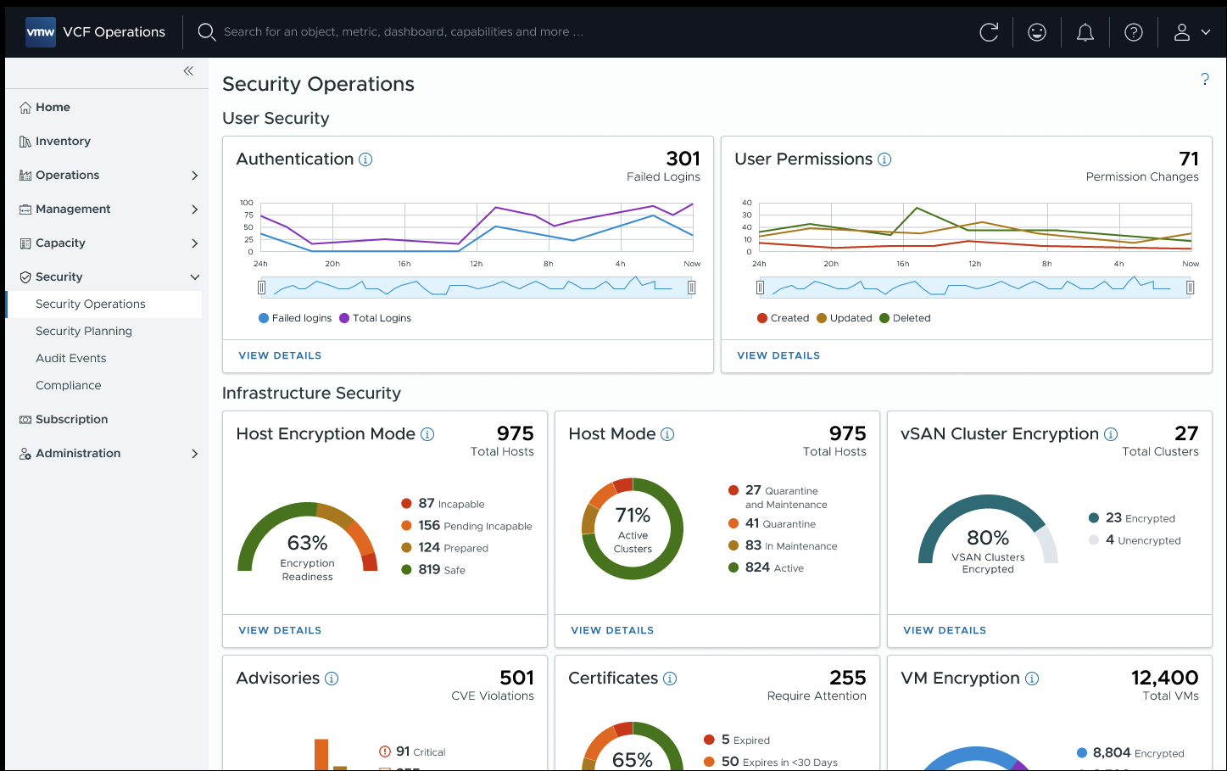
Fleet-Level Operations and VCF Security Management
Security and Resilience
Centralized Security and Compliance Management for Proactive Risk Mitigation
Fleet-Level Ops and VCF Sec Management
Customer Benefits
Detailed insights across all VCF components.
Streamlined operations reduce redundancy and improve efficiency.
Adaptable security framework for evolving needs.
Audit Support: Enhanced capabilities for security and compliance investigations.
Key Attributes
Centralized Information Hub: Provides timely and accurate security data in one place, helping users understand and mitigate risks effectively.
Comprehensive Security View: Offers visibility into multiple facets of security, covering user security, VCF component security, and more.
Scalable and Adaptable Framework: Designed to evolve with the VCF stack and organizational needs, ensuring long-term security and compliance.
The image is for illustration only
The information in this presentation is for informational purposes only and may not be incorporated
into any contract. There is no commitment or obligation to deliver any items presented herein
Notes:
Unified VCF Security Management:
With the introduction of Unified VCF Security Management across the global fleet of VCF deployments, VMware Cloud Foundation 9 will deliver a centralized security and compliance management experience for proactive risk mitigation.
A centralized information hub will provide timely and accurate security data in one place and a new comprehensive security view will provide visibility into multiple facets of security to view, manage and configure SSO, certificates, identity, passwords, notifications, tags. Configuration drift detection will correlate and proactively notify IT of inconsistencies in system configurations across an entire VCF fleet.
A single-pane-of-glass view with comprehensive visibility into all security components across the infrastructure will help customers elevate their security posture by enabling faster incident response, enhanced threat protection, and improved compliance through unified reporting, and will eventually increase the operational efficiency of the Security Operations team.

Slide 23
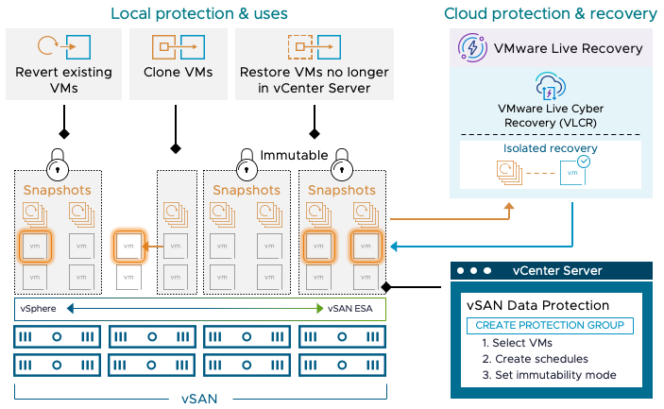
vSAN-to-vSAN Data Protection with Deep Snapshots
Security and Resilience
Elevate Data Security and Recovery with Deep vSAN-vSAN Replication
vSAN Data Protection
Customer Benefits
Quick Data Recovery: Restore data with deep, 200-level snapshots.
Efficient Site Recovery: Rapidly recover from failures with low-RPO orchestration.
Unified Management: Seamlessly control snapshots and DR in one system.
Key Attributes
Deep Snapshot Chain: Support up to 200 snapshots in a chain, allowing comprehensive data protection and recovery. Efficient local snapshots accelerate recovery while conserving storage.
Integrated DR Orchestration: Combine low-RPO Disaster Recovery with SRM and vSAN Max, ensuring rapid and reliable site recovery. Manage protection groups with multiple VMs seamlessly, reducing complexity in disaster scenarios.
Streamlined Management: Streamline disaster recovery and snapshot management through a single SRM/vR/Snap interface, providing centralized control and simplifying complex replication tasks across environments.
The image is for illustration only
The information in this presentation is for informational purposes only and may not be incorporated
into any contract. There is no commitment or obligation to deliver any items presented herein
Notes:
Native vSAN-to-vSAN Data Protection with Deep Snapshots:
vSAN remote snapshot replication will strengthen data resilience with a deep history of immutable snapshots, reduce downtime with enterprise-grade disaster recovery orchestration, and simplify the management experience with a unified appliance. It will also support vSAN storage clusters for increased scalability and storage efficiency. VCF administrators will be able to easily create, revert, restore, and clone snapshots and quickly recover from operational failures and disasters.
Customers can also leverage the deep, immutable vSAN snapshots to recover from ransomware attacks with an on-premises Isolated Recovery Environment (IRE). This complements the existing cloud-based ransomware recovery offering to provide greater choice and flexibility to customers who want to preserve data sovereignty and unlock the value of the full VCF stack to protect workloads anywhere

